Slide 1
IE 303
Introduction to Engineering Economics

Slide 2
WHAT IS ECONOMICS ?
The study of how limited resources is used to satisfy unlimited human wants

Slide 3
WHAT IS ECONOMICS ?
Engineering economy is a subset of economics for application to engineering.
Engineers seek solutions to problems, and the economic viability of each potential solution is normally considered along with the technical aspects.

Slide 4
WHAT IS ECONOMICS ?
The study of how individuals and societies choose to use scarce resources that nature and previous generations have provided.

Slide 5
RESOURCES
LAND
LABOR
CAPITAL

Slide 6

LAND
All gifts of nature, such as: water, air, minerals, sunshine, plant and tree growth, as well as the land itself which is applied to the production process.

Slide 7

LABOR
The efforts, skills, and knowledge of people which are applied to the production process.

Slide 8


CAPITAL
Real Capital (Physical Capital )
  Tools, buildings, machinery -- things which have been produced which are used in further production
Financial Capital
  Assets and money which are used in the production process
Human Capital
  Education and training applied to labor in the production process

Slide 9
Engineering economy…
involves the systematic evaluation of the economic merits of proposed solutions to engineering problems.

Slide 10
Engineering economic analysis can play a role in many types of situations.
Choosing the best design for a high-efficiency gas furnace.
Selecting the most suitable robot for a welding operation on an automotive assembly line.
Making a recommendation about whether jet airplanes for an overnight delivery service should be purchased or leased.
Determining the optimal staffing plan for a computer help desk.

Slide 11
Production Posibility Set
The production possibility set (PPS) should contain all input-output correspondences which are feasible in principle.

Slide 12
In order to construct the production possibility set we make certain assumptions:
1- Interpolation between feasible input-output points leads to new input-output correspondences which are feasible in principle;
2- Inefficient production is possible;
3- The production possibility set is the smallest set meeting these assumptions and containing all input-output correspondences observed at the units being assessed.

Slide 13
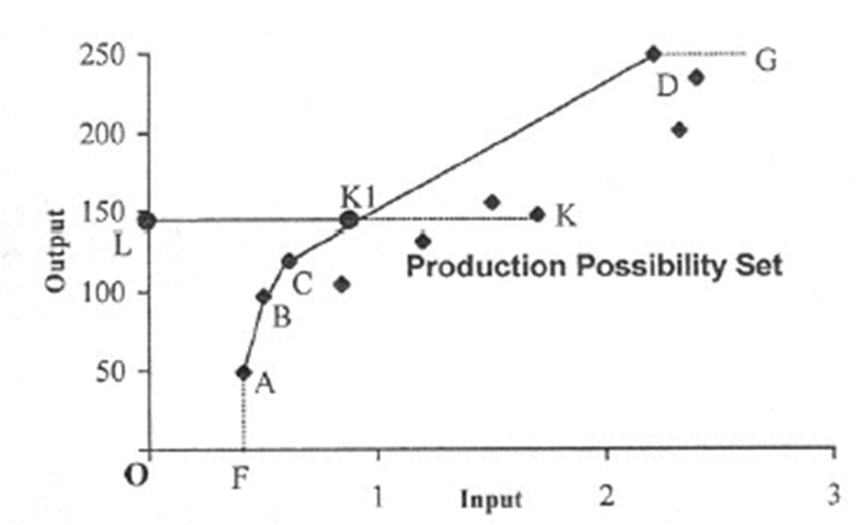

Example

Slide 14
Using interpolation assumption, all input-output correspondences lying between any two DMU can in principle be observed.
Thus the input-output correspondences along the linear segments AB, BC etc. are feasible.

Slide 15
Since inefficient production is possible, the horizontal extension from D, (DG) and the vertical drop from A, (AF) also contain input-output correspondences which are feasible.
By the same token of inefficient production, all input/output correspondences to the right and below the linear boundary FABCDG are also feasible in principle.

Slide 16
Production Posibility Set
Thus the linear boundary FABCDG and the space to the right and below this boundary is the smallest production possibility set (PPS) satisfying the assumptions and containing all DMUs under assessment.
This boundary line is called Production Possibility Frontier.

Slide 17
Video Recorders
500
Unused
Resources
300
Personel Computers
PRODUCTION POSSIBILITY FRONTIER

Slide 18
Video Recorders
500
Unavailable
Resources
Unused
Resources
300
Personel Computers
PRODUCTION POSSIBILITY FRONTIER

Slide 19
Video Recorders
500
Unused
Resources
300
500
Personel Computers
PRODUCTION POSSIBILITY FRONTIER

Slide 20
Video Recorders
600
500
Unused
Resources
300
400
Personel Computers
PRODUCTION POSSIBILITY FRONTIER

Slide 21
Origins of Engineering Economy
Pioneer: Arthur M. Wellington,
  civil engineer
  lived in latter part of nineteenth century;
  addressed role of economic analysis in engineering projects;
  area of interest: railroad building
Followed by other contributions which emphasized techniques depending on financial mathematics.

Slide 22
Engineering economic analysis procedure
Problem definition
Development of alternatives
Development of prospective outcomes
Selection of a decision criterion
Analysis and comparison of alternatives.
Selection of the preferred alternative.
Performance monitoring and postevaluation of results.

Slide 23
Principles
Focus on the differences
Use a consistent viewpoint
Use a common unit of measure
Consider all relevant criteria
Make uncertainty explicit

Slide 24

DEVELOP THE ALTERNATIVES
The final choice (decision) is among alternatives. The alternatives need to be identified and then defined for subsequent analysis.

Slide 25

FOCUS ON THE DIFFERENCES
Only the differences in expected future outcomes among the alternatives are relevant to their comparison and should be considered in the decision.

Slide 26
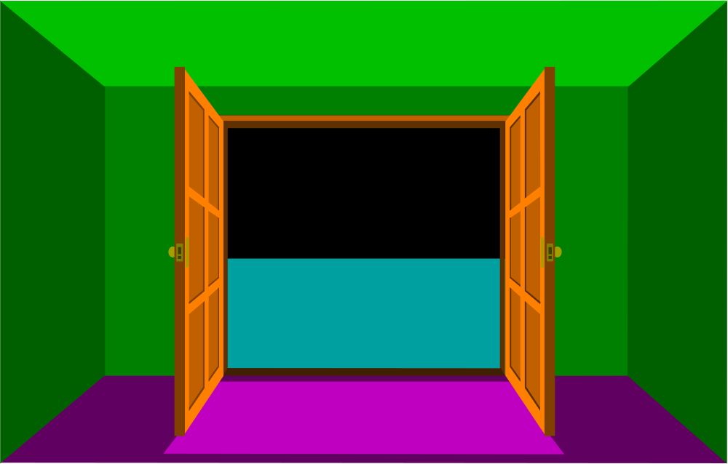

USE A CONSISTENT VIEWPOINT
The prospective outcomes of the alternatives, economic and other, should be consistently developed from a defined viewpoint (perspective).

Slide 27
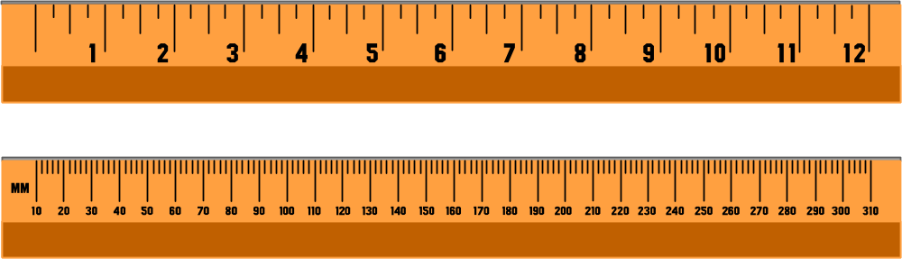
USE A COMMON UNIT OF MEASURE
Using a common unit of measurement to enumerate as many of the prospective outcomes as possible will make easier the analysis and comparison of alternatives.

Slide 28



CONSIDER ALL RELEVANT CRITERIA
Selection of a preferred alternative (decision making) requires the use of a criterion (or several criteria). The decision process should consider the outcomes enumerated in the monetary unit and those expressed in some other unit of measurement or made explicit in a descriptive manner.

Slide 29

MAKE UNCERTAINTY EXPLICIT
Uncertainty is inherent in projecting (or estimating) the future outcomes of the alternatives and should be recognized in their analysis and comparison.

Slide 30

REVISIT YOUR DECISIONS
Improved decision making results from an adaptive process; to the extent practicable, the initial projected outcomes of the selected alternative should be subsequently compared with actual results achieved.

Slide 31
A Simple Decision Model
A simple example for demonstrating the functioning of a decision model is the situation in which a production manager must decide on the question of acquiring either machine type 1 or machine type 2 for a specific operation in the job shop.
The two machines produce a specific part in batches. The setup cost per batch and the variable unit production costs are:

Slide 32

A Simple Decision Model

Slide 33
Decision Model
To formalize the situation as a Decision Model, we must
1. Identify the decision alternatives.
2. Design a criterion for evaluating the “worth” of each alternative.
3. Use the developed criterion as a basis for selecting the best of the available alternatives.

Slide 34
Decision Model
Now, the statement of the problem tells us that there are two alternatives in this problem:
1. Buy the machine type 1.
2. Buy the machine type 2.
Our objective here is obviously to select the alternative with the smaller cost.

Slide 35
Decision Model
Let x represent the number of units to be produced in a single batch (that is, the quantity produced before a new setup is needed).
The cost function (a criterion for evaluating the “worth” of each alternative) should be:

Slide 36
Decision Model
Production cost per batch
= setup cost + (variable unit cost) . x
= (50 + .4 x) for machine type 2
= (20 + .6 x) for machine type 1

Slide 37
Decision Model
Now, the complete decision model is worded as:
Select one of the alternatives:
1. Buy machine type 1
2. Buy machine type 2
The chosen alternative must yield the smaller production cost per batch.

Slide 38
Decision Model
The next step is to make a decision. We can achieve this by simply drawing a break-even chart.
Production Cost
Breakeven point
Machine 1
Machine 2
110
50
20
150
Batch Size

Slide 39
Decision Model
The two alternatives cost exactly the same at x = 150 units. The chart tells us that:
1. Buy machine 1 if the batch size is less than 150 units.
2. Buy machine 2 if the batch size is greater than 150 units.
3. Buy either machine if the batch size is exactly 150 units.

Slide 40
Decision Model
The current solution assumes that, for example, both machines will produce parts at the same rate. Suppose that in reality, the production rates of the machines are 15 and 25 units per hour for machines 1 and 2, respectively. Suppose further that the factory operates on a daily 8-hour single shift basis.

Slide 41
Decision Model
Now what happens? The new information we just provided to you adds new restrictions to the problem. Since the factory operates on a single-shift 8-hour basis, the maximum batch size for machine 1 and machine 2 are limited to 120(15x8) and 200(25x8) units, respectively.

Slide 42
Decision Model
This new information changes the shape of our figure as shown below:
Production Cost
Machine 2
Machine 1
50
20
120
200
Batch Size

Slide 43
Decision Model
This time we should
1. Buy machine 1 if the batch size is less than 120 units.
2. Buy machine 2 if the batch size is greater than 120 units and less than 200 units.
3. If the batch size is greater than 200 units, we should not buy either machine, and search for other types of machines that can produce more than 25 units per hour. (This condition is called “infeasibility”of the alternatives). In other words, the region beyond 200 units in the graphic is called infeasible region.

Slide 44
Decision Model
In summary, regardless of the level of complexity of the problem, all decision models must include three elements:
1. Decision alternatives from which a selection is made.
2. Restrictions for excluding infeasible alternatives (as in previous example).
3. A Criteria for evaluating, and ranking, the feasible alternatives.

Slide 45
ENGINEERING ECONOMY AND THE DESIGN PROCESS
An engineering economy study is accomplished using a structured procedure and mathematical modeling techniques.
The economic results are then used in a decision situation that involves two or more alternatives and normally includes other engineering knowledge and input.

Slide 46
ENGINEERING ECONOMIC ANALYSIS PROCEDURE
1. Problem recognition, formulation, and evaluation.
2. Development of the feasible alternatives.
3. Development of the cash flows for each alternative.
4. Selection of a criterion ( or criteria).
5. Analysis and comparison of the alternatives.
6. Selection of the preferred alternative.
7. Performance monitoring and post-evaluation results.

Slide 47
ACCOUNTING AND ENGINEERING ECONOMY STUDIES
Modern cost accounting may satisfy any or all of the following objectives:
1. To determine the cost of products or services
2. To provide a rational basis for pricing goods or services
3. To provide a means for controlling expenditures
4. To provide information on which operating decisions may be based and the results evaluated

Slide 48
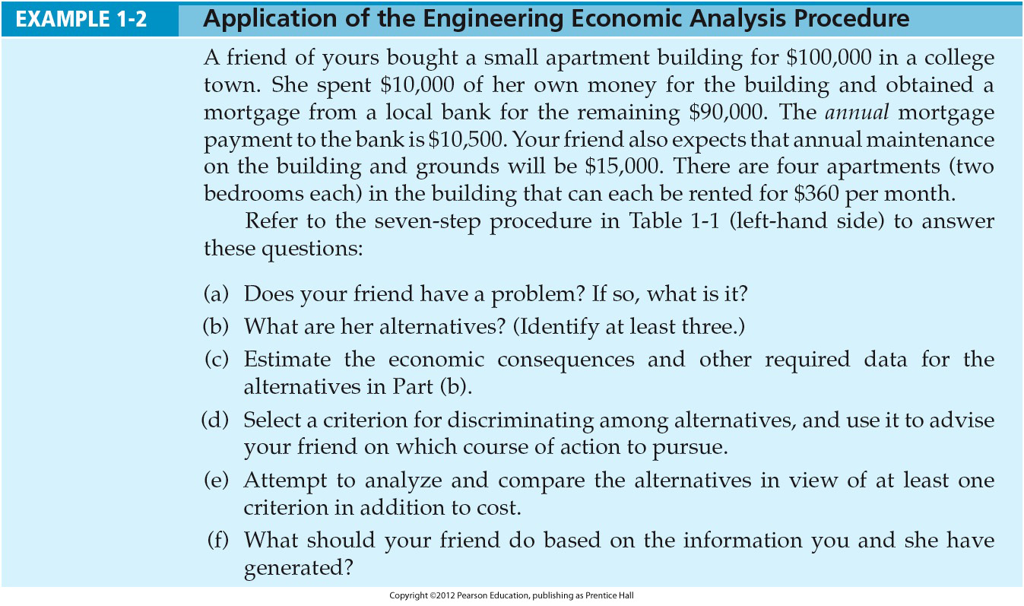

Slide 49
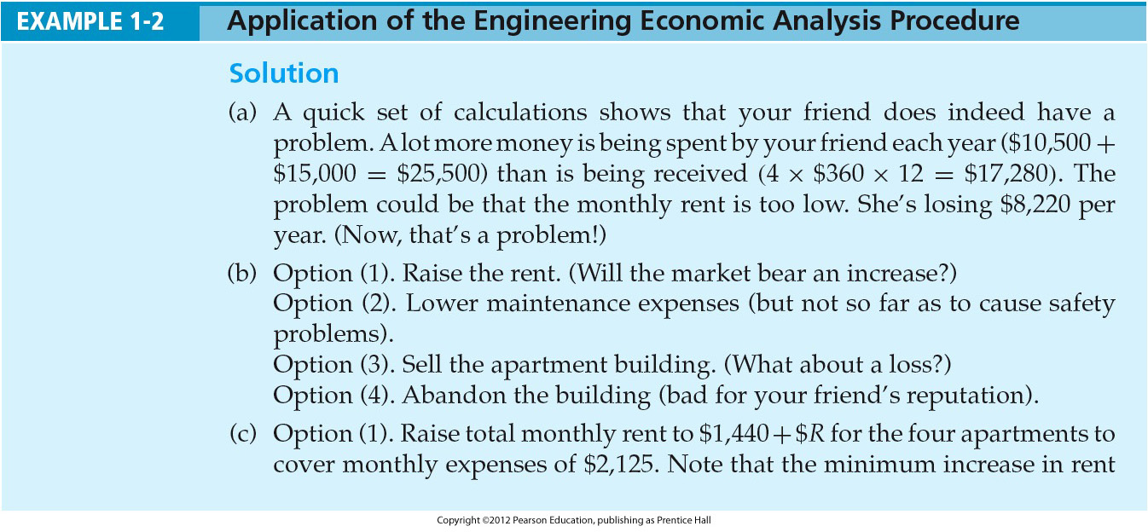

Slide 50
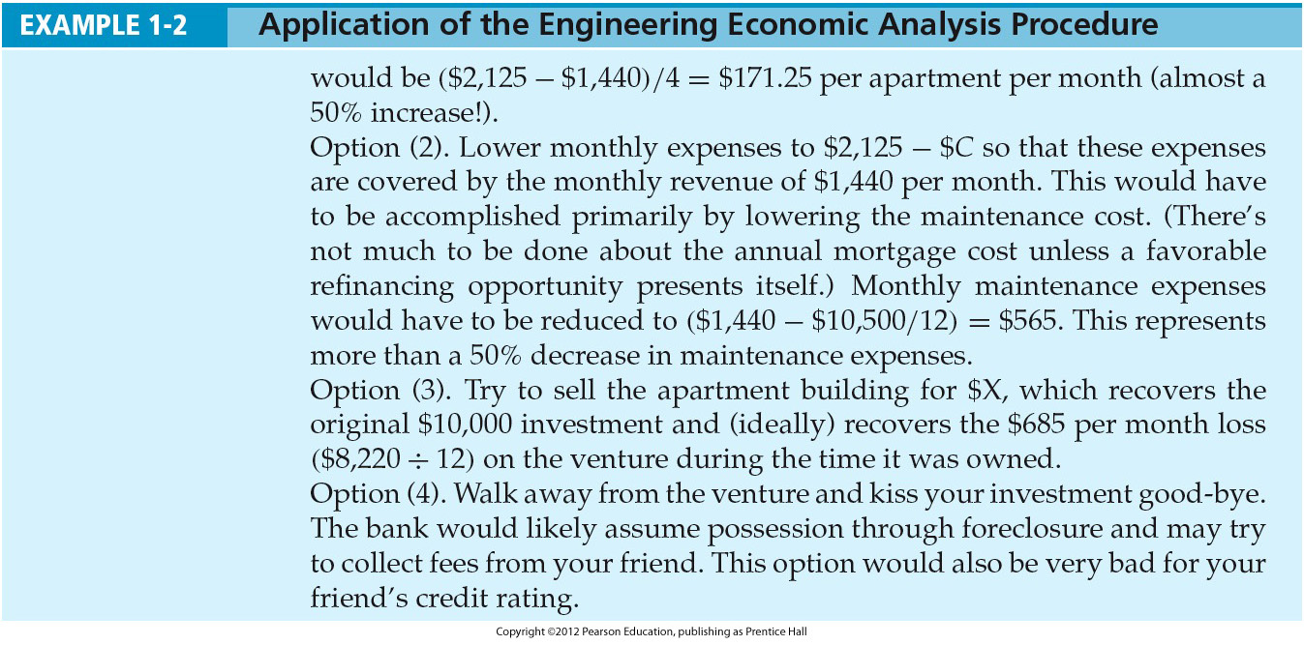

Slide 51
Electronic spreadsheets are a powerful addition to the analysis arsenal.
Most engineering economy problems can be formulated and solved using a spreadsheet.
Large problems can be quickly solved.
Proper formulation allows key parameters to be changed.
Graphical output is easily generated.

